Slide 1
KeyStone Multicore Navigator
KeyStone Training
Multicore Applications
Literature Number: SPRP812

Slide 2
Objectives
The purpose of this lesson is to enable you to do the following:
Explain the advantages of using Multicore Navigator.
Explain the functional role of descriptors and queues in the Multicore Navigator.
Describe Multicore Navigator architecture and explain the purpose of the Queue Manager Subsystem and Packet DMA.
Identify Multicore Navigator parameters that are configured during initialization and how they impact run-time operations.
Identify the TI software resources that assist with configuration and usage of the Multicore Navigator.
Apply your knowledge of Multicore Navigator architecture, functions, and configuration to make decisions in your application development.

Slide 3
Agenda
Part 1: Understanding Multicore Navigator:
Functional Overview and Use Cases
System Architecture
Implementation Examples
Part 2: Using Multicore Navigator:
Configuration
LLD Support
Project Examples

Slide 4
Understanding Multicore Navigator: Functional Overview and Use Cases
KeyStone Multicore Navigator

Slide 5
Motivation
Multicore Navigator is designed to enable the following:
Efficient transport of data and signaling
Offload non-critical processing from the cores, including:
Routine data into the device and out of the device
Inter-core communication
Signaling
Data movement “loose link”
Minimize core intervention: Fire and forget
Load balancing through a centralized logic control that monitors execution status in all cores
A standard KeyStone architecture

Slide 6
Basic Elements
Data and/or signaling is carried in software structures called Descriptors:
Contain information and data
Allocated in device memory
Descriptors are pushed and popped to and from hardware Queues:
Cores retrieve descriptors out of queues to load data
Cores get data from descriptors
When descriptors are created, they are pushed into special storage queues called Free Descriptor Queues (FDQ).

Slide 7
Typical Use Cases (1)
Send routing data out via a peripheral:
Core 1 generates data to be sent out.
Core 1 gets an unused descriptor from a FDQ.
Core 1 connects data to the descriptor.
If the destination is not yet defined, Core 1 defines the destination and adds more information to the descriptor (as needed).
Core 1 pushes the descriptor to a (dedicated TX) queue. At this point, Core 1 is done.
Multicore Navigator hardware sends the data via the peripheral to the destination.
The used descriptor is recycled back to the FDQ.

Slide 8
Typical Use Cases (2)
Getting data from a peripheral to a pre-defined core destination:
Peripheral receives external data with protocol-specific destination routing information.
Multicore Navigator hardware inside the peripheral gets a descriptor from FDQ and loads data to the descriptor.
Based on Receive Flow “rules” and protocol routing information, Multicore Navigator hardware pushes the descriptor into a queue associated with the destination (Core 1)
At this point, the destination (Core 1) pops the descriptor from the queue, reads the data, and recycles the descriptor back to the FDQ.

Slide 9
Typical Use Cases (3)
Send data from one core to another core.
Core 1 generates data to be sent out.
Core 1 gets an unused descriptor from a FDQ.
Core 1 connects data to the descriptor.
If the destination is not yet defined, Core 1 defines the destination and adds more information to the descriptor, as needed.
Core 1 pushes the descriptor to a queue. At this point, Core 1 is done.
The hardware sends the data to a queue that is associated with Core 2.
At this point, Core 2 pops the descriptor from the queue, reads the data, and recycles the descriptor to the FDQ.

Slide 10
Understanding Multicore Navigator: System Architecture
KeyStone Multicore Navigator

Slide 11
KeyStone Navigator Components
The Queue Manager Subsystem (QMSS) is a centralized hardware unit that monitors core activity and manages the queues.
Multiple Packet DMA (PKTDMA) engines use descriptors between transmit and receive queues packets that are dedicated to “routing” peripherals or to the Multicore Navigator infrastructure. NOTE: PKTDMA was previously called CPPI (Communication Peripheral Port Interface)
Memory Subsystem
Application-Specific
MSM
Coprocessors
DDR3 EMIF
SRAM
MSMC
C66x™
CorePac
L1P
L1D
Cache/RAM
Cache/RAM
L2 Memory Cache/RAM
Miscellaneous
1 to 8 Cores @ up to 1.25 GHz
HyperLink
TeraNet
Multicore Navigator
Queue
Packet
Manager
DMA
External Interfaces
Network Coprocessor
Notes:
11
NEW

Slide 12
QMSS Architecture (KeyStone 1)
Major HW components of the QMSS:
Queue Manager and 8192 queue headers
Two PDSPs (Packed Data Structure Processors):
Descriptor Accumulation / Queue Monitoring
Load Balancing and Traffic Shaping
TI provides firmware code to the APDSP; The user does not develop any firmware code.
Interrupt Distributor (INTD) module
Two timers
Internal RAM: A hardware link list for descriptor indices (16K entries)
Infrastructure PKTDMA supports internal traffic (core to core)

Slide 13
KeyStone II QMSS Architecture

Slide 14
Keystone I Queue Mapping
Queue Range | Count | Hardware Type | Purpose
0 to 511 | 512 | pdsp/firmware | Low Priority Accumulation queues
512 to 639 | 128 | queue pend | AIF2 Tx queues
640 to 651 | 12 | queue pend | PA Tx queues (PA PKTDMA uses the first 9 only)
652 to 671 | 20 | queue pend | CPintC0/intC1 auto-notification queues
672 to 687 | 16 | queue pend | SRIO Tx queues
688 to 695 | 8 | queue pend | FFTC_A and FFTC_B Tx queues (688..691 for FFTC_A)
696 to 703 | 8 |  | General purpose
704 to 735 | 32 | pdsp/firmware | High Priority Accumulation queues
736 to 799 | 64 |  | Starvation counter queues
800 to 831 | 32 | queue pend | QMSS Tx queues
832 to 863 | 32 |  | Queues for traffic shaping (supported by specific firmware)
864 to 895 | 32 | queue pend | HyperLink queues for external chip connections
896 to 8191 | 7296 |  | General Purpose

Slide 15
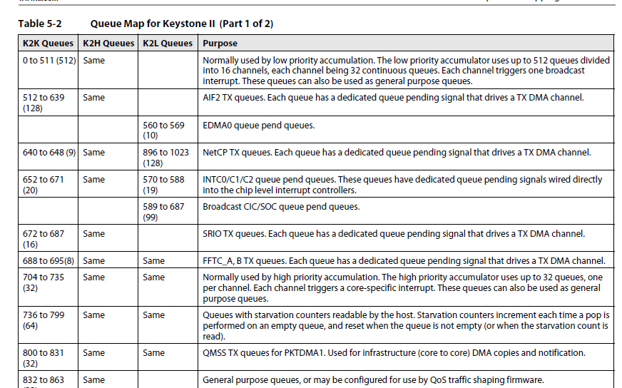
Keystone II Queue Mapping

Slide 16
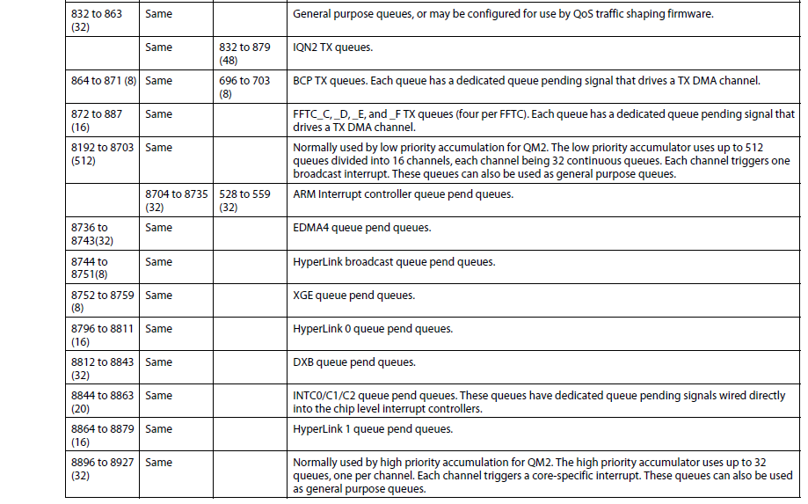
Keystone II Queue Mapping

Slide 17
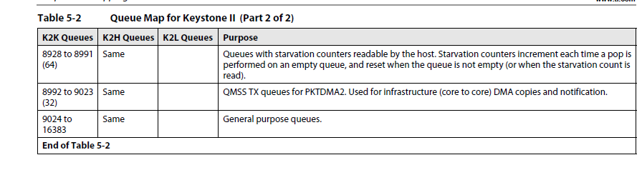
Keystone II Queue Mapping

Slide 18
QMSS: Descriptors
Descriptors move between queues and carry information and data.
Descriptors are allocated in memory regions. Indices to descriptors are in the internal or external link ram
KeyStone I
Up to 20 memory regions may be defined for descriptor storage (LL2, MSMC, DDR).
Up to 16K descriptors can be handled by internal Link RAM (Link RAM 0)
Up to 512K descriptors can be supported in total
Keystone II
Up to 64 memory regions may be defined for descriptor storage (LL2, MSMC, DDR) per QM***
Up to 32K descriptors can be handled by internal Link RAM (Link RAM 0)
Up to 512K descriptors can be supported in total for QM

Slide 19
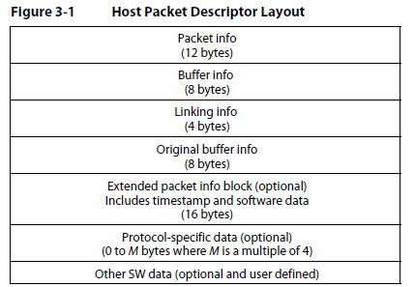
Host Descriptors Structure

Slide 20
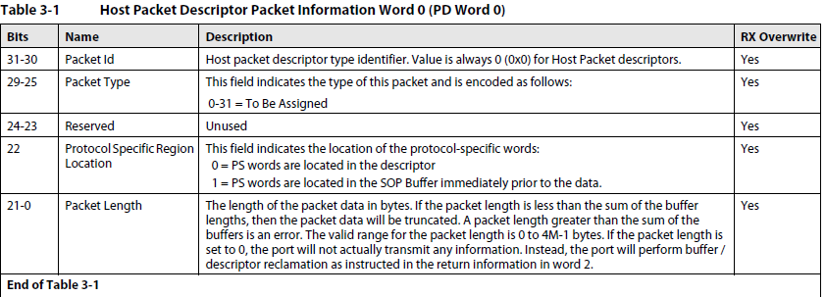
Understanding Host Descriptors Structure – first 4 bytes
All other bytes are defined in the following tables

Slide 21
QMSS: Descriptor Memory Regions
All Multicore Navigator descriptor memory regions are divided into equal-sized descriptors. For example:
Memory regions are always aligned to 16-byte boundaries and descriptors are always multiples of 16 bytes.
The number of descriptors in a region is always power of 2 (at least 32).

Slide 22
QMSS: Descriptor Types
Two descriptor types are used within Multicore Navigator:
Host type provide flexibility, but are more difficult to use:
Contains a header with a pointer to the payload.
Can be linked together; Packet length is the sum of payload (buffer) sizes.
Monolithic type are less flexible, but easier to use:
Descriptor contains the header and payload.
Cannot be linked together
All payload buffers are equally sized (per region).

Slide 23
Descriptors and Queues
When descriptors are created, they are loaded with pre-defined information and are pushed into the Free Descriptor Queue(s) – one of the general purpose queues
When a master (core or PKTDMA) needs to use a descriptor, it pops it from a FDQ.
Each descriptor can be pushed into any one of the 8192 queues (in KeyStone I devices).
16K descriptors; Each can be in any queue. How much hardware is needed for the queues?

Slide 24
Descriptors and Queues (2)
The TI implementation uses the following elements to manage descriptors and queues:
The link list (Link RAM) indexes all descriptors.
The queue header points to the top descriptor in the queue.
A NULL value indicates the last descriptor in the queue.
When a descriptor pointer is pushed or popped, an index is derived from the queue push/pop pointer.
When a descriptor is pushed onto a queue, the queue manager converts the address to an index. The descriptor is added to the queue by threading the indexed entry of the Link RAM into the queue’s linked list.
When a queue is popped, the queue manager converts the index back into an address. The Link RAM is then rethreaded to remove this index.

Slide 25
Descriptors and Queues (3)
Each queue has a hardware structure that maintains:
The value of the Head index
The value of the tail index
Entry count
Byte count
Head element packet size
Head element descriptor size
Each Queue has 4 MMR A,B,C and D that are used to get information about descriptors in the queue, to set option (tail or head push, pop is always tail) and to push (write to the D register) and pop (read from the D register) descriptors in and out the queue

Slide 26
Descriptors and Queues (4)
Read or write registers C or D cause changes in the queue
Two additional sets of “shadow” registers for ABCD –
Peek region
Proxy region
Software low level drivers (LLD) hide these details from the user

Slide 27
QMSS: Descriptor Queuing (1) – Push descriptor into empty Queue

Slide 28
QMSS: Descriptor Queuing (2) – Push descriptor into Head Queue (FIFO)

Slide 29
QMSS: Descriptor Queuing (3) – Push descriptor into Tail Queue (LIFO)

Slide 30
QMSS: Descriptor Queuing (4)

Slide 31
QMSS: Descriptor Queuing (5) – Pop always from the tail

Slide 32
Descriptor Queuing: Explicit and Implicit
This diagram shows several descriptors queued together. Things to note:
Only the Host Packet is queued in a linked Host Descriptor.
A Host Packet is always used at SOP, followed by zero or more Host Buffer types.
Multiple descriptor types may be queued together, though this is not commonly done in practice.

Slide 33
Descriptor and Accumulators Queues
Accumulators keep the cores from polling.
Running in the background, they interrupt a core with a list of popped descriptor addresses (the list is in accumulation memory).
Core software must recycle.
High-Priority Accumulator:
32 channels, one queue per channel
All channels scanned each timer tick (25us)
Each channel/event maps to 1 core
Programmable list size and options
Low-Priority Accumulator:
16 channels, up to 32 queues per channel
1 channel is scanned each timer tick (25 us)
Each channel/event maps to any core (broadcast)
Programmable list size and options

Slide 34
Packet DMA Topology
FFTC (B)
FFTC (A)
Queue Manager Subsystem
SRIO
PKTDMA
Queue Manager
0
PKTDMA
1
PKTDMA
2
3
4
5
.
BCP
.
.
8192
PKTDMA
PKTDMA
Network Coprocessor (NETCP)
AIF
PKTDMA
PKTDMA
Multiple Packet DMA instances in KeyStone devices:
NETCP and SRIO instances for all KeyStone devices.
FFTC (A and B), BCP, and AIF2 instances are only in KeyStone devices for wireless applications.
Notes:
NEW

Slide 35
Packet DMA (PKTDMA)
Major components for each instance:
Multiple RX DMA channels
Multiple TX DMA channels
Multiple RX flow channels. RX flow defines behavior of the receive side of the navigator.

Slide 36
Packet DMA (PKTDMA) Features
Independent Rx and Tx cores:
Tx Core:
Tx channel triggering via hardware qpend signals from QM.
Tx core control is programmed via descriptors.
4 level priority Tx Scheduler
Rx Core:
Rx channel triggering via Rx Streaming I/F
Rx core control programmed via “Rx Flow”
2x128-bit symmetrical streaming I/F for Tx output and Rx input
Wired together for loopback within the QMSS PKTDMA instance
Connects to matching streaming I/F (Tx->Rx, Rx->Tx) of peripheral
Packet-based; So neither the Rx or Tx cores care about payload format.

Slide 37
Understanding Multicore Navigator: Implementation Examples
KeyStone Multicore Navigator

Slide 38
Example 1: Send Data to Peripheral or Coprocessor
Core pops a descriptor from FDQ, loads information and data, pushes it into a TX queue.
The TX queue generates a pending signal that wakes up the PKTDMA
PKTDMA reads the information and the.
The peripheral converts the data to bit stream and sends it to the destination as defined by the descriptor information.
The PKTDMA recycles the descriptor and the buffer by pushing the descriptor into a FDQ that is specified in the descriptor information.

Slide 39
Example 2: Receive Data from Peripheral or Coprocessor
Rx PKTDMA receives packet data from Rx Streaming I/F.
Using an Rx Flow, the Rx PKTDMA pops an Rx FDQ.
Data packets are written out to the descriptor buffer.
When complete, Rx PKTDMA pushes the finished descriptor to the indicated Rx queue.
The core that receives the descriptor must recycle the descriptor back to an Rx FDQ.

Slide 40
A Word About Infrastructure Packet DMA
The Rx and Tx Streaming I/F of the QMSS PKTDMA are wired together to enable loopback.
Data packets sent out the Tx side are immediately received by the Rx side.
This PKTDMA is used for core-to-core transfers.
Because the DSP is often the recipient, a descriptor accumulator can be used to gather (pop) descriptors and interrupt the host with a list of descriptor addresses. The host must recycle them.

Slide 41
Example 3: Core-to-Core (Infrastructure) (1/2)
The DSP pushes a descriptor onto a Tx queue of the QMSS PKTDMA.
The Tx PKTDMA pops the descriptor, sends the data out the Streaming I/F, and recycles the descriptor.
The Rx PKTDMA is triggered by the incoming Streaming I/F data and pops an Rx FDQ.
Queue Manager (QMSS)
push
pop
Tx Free Desc Queue
Rx Free Desc Queue
Tx PKTDMA
Rx PKTDMA
Tx Queue
Rx Queue
pop
push
d
e
a
t
i
e
r
r
w
buffer
buffer
buffer
buffer
buffer
buffer
buffer
buffer
TeraNet SCR
Memory
Memory

Slide 42
Example 3 Core-to-Core (Infrastructure) (2/2)
The Rx PKTDMA then pushes the finished descriptor to an Rx queue.
If the Rx queue is an Accumulation queue, the accumulator pops queue and eventually interrupts the DSP with the accumulated list.
The destination DSP consumes the descriptors and pushes them back to an Rx FDQ.
Queue Manager (QMSS)
push
pop
Tx Free Desc Queue
Rx Free Desc Queue
Tx PKTDMA
Rx PKTDMA
Tx Queue
Rx Queue
pop
push
d
e
a
t
i
e
r
r
w
buffer
buffer
buffer
buffer
buffer
buffer
buffer
buffer
TeraNet SCR
Memory
Memory

Slide 43
Example 4: Send data from C66 to C66, zero copy
Queue Manager (QMSS)
pop
Core 0
Tx Free Desc Queue
Rx queue of core 1
Core 1
push
buffer
buffer
buffer
buffer
Memory
The location of the descriptors and the buffer – MPAX setting
Access to the FDQ
Coherency

Slide 44
User Space ARM-C66 core issues
Queue Manager (QMSS)
pop
Core 0
Tx Free Desc Queue
Rx queue of core 1
Core 1
push
buffer
buffer
buffer
buffer
Memory
Continuous memory
Location of buffers and descriptors (logical-physical)
ARM coherency toward the DSP
Losing memory protection
FDQ physical location and free buffers

Slide 45
User Space ARM-C66 core issues
Using Linux drivers from User space hide the difficulties from the user
For each process, memories (description regions, buffers location) are configured during initialization using continuous memory allocator (so the overhead in calling the allocator routines is just during initialization)
FDQ pop gives virtual memory to user space. Push accepts virtual memory. QMSS drivers know how to do the translation
All communications from user space involve infrastructure PKTDMA (1 copy, ARM coherency)
No user space interrupt (only poll)

Slide 46
Using Multicore Navigator: Configuration
KeyStone Multicore Navigator

Slide 47
Using the Multicore Navigator
Configuration and initialization
Configure the QMSS
Configure the PKTDMA
Run-time operation
Push descriptors
Pop descriptors
LLD functions (QMSS and CPPI) are used for both configuration and run-time operations.

Slide 48
What Needs to Be Configured?
Link Ram: Up to two Link RAM
One internal, Region 0, address 0x0008 0000, size up to 16K
One External, global memory, size up to 512K
Memory Regions: Where descriptors actually reside
Up to 20 regions, 16 byte alignment
Descriptor size is multiple of 16 bytes, minimum 32
Descriptor count (per region) is power of 2, minimum 32
Configuration: base address, start index in the LINK RAM, size and number of descriptors
Loading PDSP firmware

Slide 49
What Needs to Be Configured?
Descriptors
Create and initialize.
Allocate data buffers and associate them with descriptors.
Queues
Open transmit, receive, free, and error queues.
Define receive flows.
Configure transmit and receive queues.
PKTDMA
All PKTDMA in the system
Special configuration information used for PKTDMA

Slide 50
Information about the Navigator Configuration
QMSS LLDs are described in the file:
\pdk_C6678_X_X_X_X\packages\ti\drv\qmss\docs\doxygen\html\group___q_m_s_s___l_l_d___f_u_n_c_t_i_o_n.html
PKTDMA (CPPI) LLDs are described in the file:
\pdk_C6678_X_X_X_X\packages\ti\drv\cppi\docs\doxygen\html\group___c_p_p_i___l_l_d___f_u_n_c_t_i_o_n.html
Information on how to use these LLDs and how to configure the Multicore Navigator are provided in the release examples.
LINUX QMSS and CPPI drivers provide the same functionality on the ARM-Linux. TransportNetLib library http://processors.wiki.ti.com/index.php/TransportNetLib_UsersGuide describe the memory utility that is used

Slide 51
Using Multicore Navigator: LLD Support
KeyStone Multicore Navigator

Slide 52
QMSS Low Level Driver (LLD)
The LLD provide an abstraction of register-level details.
Two usage modes:
User manages/selects resources to be used.
Generally faster
LLD manages/selects resources.
Generally easier
A minimal amount of memory is allocated for bookkeeping purposes.
Built as two drivers:
QMSS LLD is a standalone driver for Queue Manager and Accumulators.
CPPI LLD is a driver for PKTDMA that requires the QMSS LLD.
The following slides do not present the full set of APIs.

Slide 53
QMSS LLD Initialization
The following APIs are one-time initialization routines to configure the LLD globally:
Qmss_init(parms, queue_mapping);
Configures Link RAM, # descriptors, queue mapping
May be called on one or all cores
Qmss_exit();
De-initializes the QMSS LLD

Slide 54
QMSS Configuration
More QMSS configuration APIs:
Qmss_start( );
Called once on every core to initialize config parms on those cores.
Must be called immediately following Qmss_init()
Qmss_insertMemoryRegion(mem_parms);
Configures a single memory region.
Should be called with protection so that no other tasks or cores could simultaneously create an overlapping region.

Slide 55
QMSS LLD Queue Usage
APIs to allocate and release queues:
queue_handle = Qmss_queueOpen(type, que, *flag);
Once “open”, the DSP may push and pop to the queue.
type refers to an enum (tx queue, general purpose, etc.).
que refers to the requested queue number.
flag is returned true if the queue is already allocated.
Qmss_queueClose(queue_handle);
Releases the handle, preventing further use of the queue

Slide 56
Queue Push and Pop
Queue management APIs:
Qmss_queuePushDesc(queue_handle, desc_ptr);
Pushes a descriptor address to the handle’s queue
Other APIs are available for pushing sideband info
desc_ptr = Qmss_queuePop(queue_handle);
Pops a descriptor address from the handle’s queue
count = Qmss_getQueueEntryCount(queue_handle);
Returns the number of descriptors in the queue

Slide 57
QMSS Accumulator
The following API functions are available to program, enable, and disable an accumulator:
Qmss_programAccumulator(type, *program);
Programs/enables one accumulator channel (high or low)
Setup of the ISR is done outside the LLD using INTC
Qmss_disableAccumulator(type, channel);
Disables one accumulator channel (high or low)

Slide 58
CPPI LLD Initialization
The following APIs are one-time initialization routines to configure the LLD globally:
Cppi_init(pktdma_global_parms);
Configures the LLD for one PKTDMA instance
May be called on one or all cores
Must be called once for each PKTDMA to be used
Cppi_exit();
Deinitializes the CPPI LLD

Slide 59
CPPI LLD: PKTDMA Channel Setup
More handles to manage when using the PKTDMA LLD.
APIs to allocate a handle for a PKTDMA:
pktdma_handle = CPPI_open(pktdma_parms);
Returns a handle for one PKTDMA instance
Called once for each PKTDMA required
APIs to allocate and release Rx channels:
rx_handle = Cppi_rxChannelOpen(pktdma_handle, cfg, *flag);
Once “open”, the DSP may use the Rx channel.
cfg refers to the setup parameters for the Rx channel.
flag is returned true if the channel is already allocated.
Cppi_channelClose(rx_handle);
Releases the handle, thus preventing further use of the queue

Slide 60
More Packet DMA Channel Setup
APIs to allocate and release Tx channels:
tx_handle = Cppi_txChannelOpen(pktdma_handle, cfg, *flag);
Same as the Rx counterpart
Cppi_channelClose(tx_handle);
Same as the Rx counterpart
To configure/open an Rx Flow:
flow_handle = Cppi_configureRxFlow(pktdma_handle, cfg, *flag);
Similar to the Rx channel counterpart

Slide 61
PKTDMA Channel Control
APIs to control Rx and Tx channel use:
Cppi_channelEnable(tx/rx_handle);
Allows the channel to begin operation
Cppi_channelDisable(tx/rx_handle);
Allows for an immediate, hard stop
Usually not recommended unless following a pause
Cppi_channelPause(tx/rx_handle);
Allows for a graceful stop at next end-of-packet
Cppi_channelTeardown(tx/rx_handle);
Allows for a coordinated stop

Slide 62
Using Multicore Navigator: Project Examples
KeyStone Multicore Navigator

Slide 63
Examples
Part of PDK (Platform Development Kit) release is a set of examples for each of the peripherals.
Several examples use the Multicore Navigator and can be used as starting point for development.
Location of the examples:
pdk_keystone2_X_XX_XX_XX\packages\exampleProjects
Examples that use Multicore Navigator:
QMSS
CPPI (PKTDMA)
NETCP: PA
SRIO

Slide 64
For More Information
For more information, refer to the to Multicore Navigator User Guide http://www.ti.com/lit/SPRUGR9
For questions regarding topics covered in this training, visit the support forums at the TI E2E Community website.

